Slide 1


Remarkably Resilient Together™
An Employee Wellbeing Campaign in partnership with
Johnson County Mental Health Center
Remarkably Resilient® and Remarkably Resilient Together™ are trademarks of TeamTech, LLC. Materials supporting the Remarkably Resilient and Remarkably Resilient Together programs and courses, including but not limited to the Remarkably Resilient Together PowerPoint, card decks, and reflective journals, all of which are subject to protection by U.S. registered trademarks and copyrights. For more information, contact TeamTech, LLC at www.teamtechinc.com. Permission is granted to use this PowerPoint with the RRT materials; all trademarks and copyrights are reserved.

Slide 2
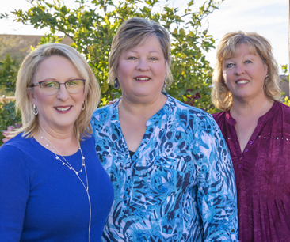
Remarkably Resilient Together The WHY
We, the Harnish sisters, wrote Remarkably Resilient: Community Matters to share our journeys of resilience out of a childhood home of multi-generational incest, abuse, and neglect.
The neuroscience of trauma helped us understand our WHY and our HOW:
  WHY did we have so many chronic health conditions?
  HOW had we all three been able to break the multi-generational cycle of incest and abuse in our paternal family?
Kathleen, Karen, Sharon

Slide 3
Remarkably Resilient Together The WHY
Our lived experience informed by the neuroscience of trauma led us to our 4 R’s of Resilience: Relationships, Response, Recovery, and Regulation.
We felt our childhood happened to us so as older adults we can now share with others what the neuroscience of trauma can teach us all about being more resilient.
As we considered our 4 R’s of Resilience, we knew that helping everyone start from a firm foundation of Regulation and Self-Care was where the Remarkably Resilient Together (RRT) series should start.
Kathleen, Karen, Sharon

Slide 4
Remarkably Resilient Together The WHY
Everyone experiences trauma.
Resilience helps us weather those ups and downs.
We are all more resilient when we are regulated with full resilience cups! That is our mantra for the first of the Remarkably Resilient Together series.
Kathleen, Karen, Sharon

Slide 5
Remarkably Resilient Together
Developed in accordance with the neuroscience of trauma
Utilizes the evidence-based practice of journaling and self-reflection
Grounded in lived experience
Follow along in your Reflective Journal: page 1

Slide 6
Remarkably Resilient Together Our Hope
From the Harnish sisters: Our hope is that by helping people at the individual level, the impact ripples out to families, organizations, neighborhoods, communities, and beyond.
We are all more resilient humans when we are regulated with a full resilience cup.
Why is this important to us?
Follow along in your Reflective Journal: pages 2-3

Slide 7
Remarkably Resilient Together The WHY
Gallup’s annual State of the Global Workplace: 2022 Report: Wellbeing Matters
We all experience times when we feel out of sorts from stressors, triggers, past traumas, etc.
Lived experience also matters: ACEs, the Pair of ACEs
Follow along in your Reflective Journal: pages 4 – 6

Slide 8
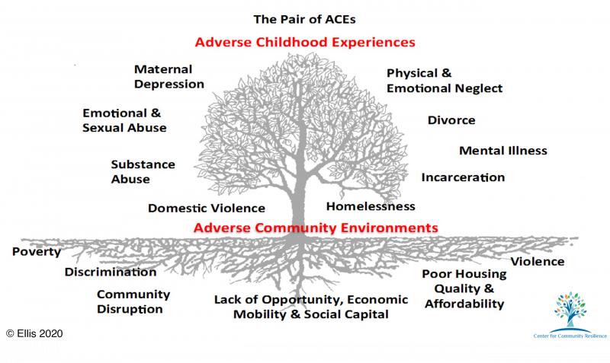
PAIR OF ACES
Follow along in your Reflective Journal: page 5

Slide 9
Remarkably Resilient Together What is Trauma?
SAMHSA (Substance Abuse and Mental Health Services Administration) defines trauma using the 3 E’s:
“Individual trauma results from an event, series of events, or set of circumstances that is experienced by an individual as physically or emotionally harmful or life threatening and that has lasting adverse effects on the individual’s functioning and mental, physical, social, emotional, or spiritual well-being.”
The 3 E’s helps us understand the same Event will not necessarily impact (Experiences, Effects) everyone the same.
Follow along in your Reflective Journal: page 7

Slide 10
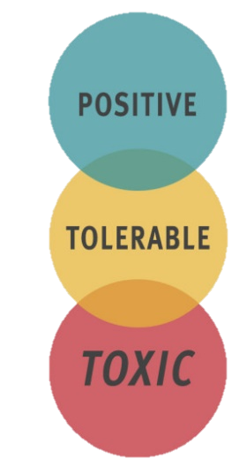
From Harvard University’s
Center on the Developing Child
Stress Its Impact
Brief increase in heart rate; Mild increase in stress hormones
Serious and temporary stress response; Lessened by support systems
Long activation of stress response; Lack of support systems
Follow along in your Reflective Journal: page 7

Slide 11
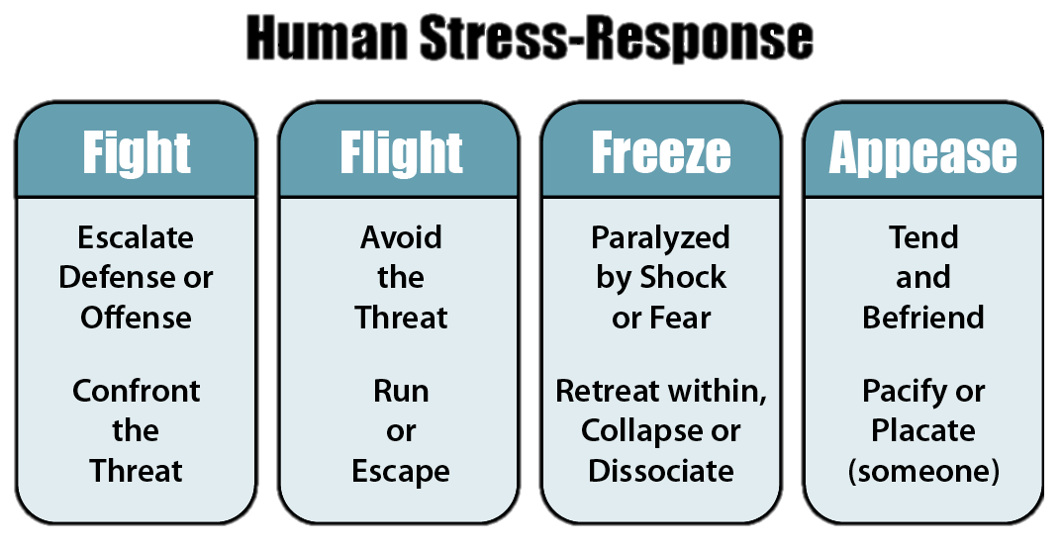
Follow along in your Reflective Journal: page 8

Slide 12
Defining Terms
Emotional Regulation: The ability to manage your emotions so they don’t manage you.
Triggers: Sensory reminders that awaken a painful memory and can cause sudden emotional and physical reactions.
Dysregulation: An ongoing difficulty handling stressors and triggers; Your reactivity level is higher than is necessary for everyday situations.
Later – you may want to come back and read the personal reflection on page 10.
Follow along in your Reflective Journal: pages 9 – 10

Slide 13
Triggers and Dysregulation
Stress-Response When it is NOT Needed
  What becomes challenging for your physical and mental health is when your stress-response system (fight, flight, freeze, or appease) is activated when it does not need to be. You have been triggered or are dysregulated.
  Reflection: Are you the best version of yourself when you are in survival mode when you don’t need to be?
Follow along in your Reflective Journal: page 8

Slide 14
Empathy-Based Trauma
Vicarious Trauma: Results when a person’s worldview shifts negatively challenging their sense of safety and trust.
Secondary Trauma: Caused by exposure to a traumatic incident coupled with feelings of grief, depression, anxiety, or even suicidal ideation.
Compassion Fatigue: Occurs when helping professionals are unable to adequately rest and renew their resilience capability. In most definitions, it includes burnout and secondary trauma.
Later – you may want to come back and read the personal reflection on page 13.
Follow along in your Reflective Journal: pages 11 – 13

Slide 15
The Root Cause Nature of Trauma
Neuroscience is clear!
Understanding the impact of trauma on the brain and body and its subsequent possible long-term impacts on physical, mental, and emotional health is to understand the root cause nature of trauma. The long-term impacts can look like:
Chronic disease, Mental Illness, Lower Life Potential, Substance Use and Addiction and even a shorted Life Span
Flipping the question from “What’s wrong with you?” to
“What happened to you?”
Later – you may want to come back and read the personal reflections on pages 19 - 20.
Follow along in your Reflective Journal: pages 19 - 20

Slide 16
Regulation, Self-Care and Resilience
We are more resilient humans when we are regulated with full resilience cups! Let’s get there together!

Slide 17
Regulation and Resilience
Learning to be a regulated human strengthens your resilience.
Recognize when you are triggered or dysregulated. Know your signs.
Communicate (if you are able) what you are experiencing. “This is upsetting to me. I need a moment.”
Regulate. Do a regulating activity. Something that is healthy, soothing, and calming to you. Rhythmic and repetitive.
Notice. What happened when you tried a regulating activity?
Follow along in your Reflective Journal: pages 14 - 16 AND behind the Green Divider

Slide 18
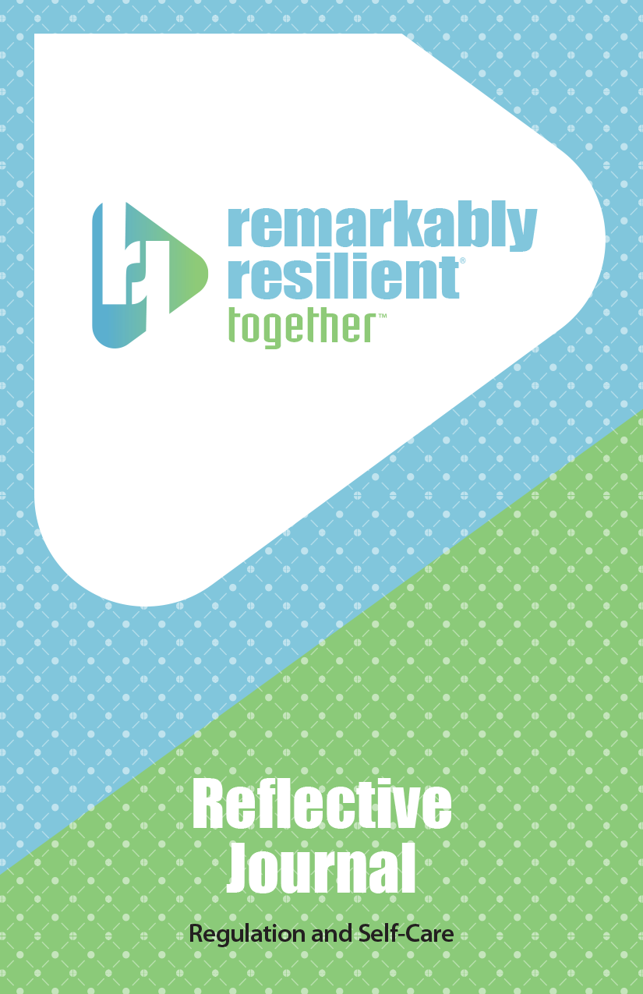
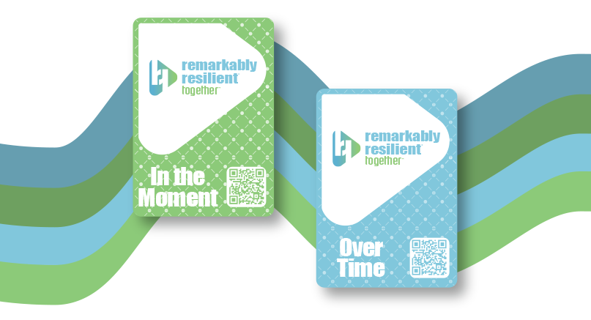
Remarkably Resilient Together
“In the Moment” Cards
Exercise
Take a moment and look at your “In the Moment” cards (green card deck)
Select one that speaks to you.
In pairs or triads, share the cards you each have and talk about how each suggestion can be regulating
Using the Reflective Journal; Look behind the Green Divider,
Pages 26 – 46

Slide 19
Self-Care and Resilience
Self-care is the practice of taking an active role in protecting one’s own well-being and happiness. Often, we think about self-care in times of stress.
Remarkably Resilient Together encourages thinking about self-care as a regular activity to keep your resilience cup full so you can weather life’s ups and downs.
Reflection: Are you the best version of yourself when your resilience cup is low or empty?

Slide 20
Self-Care and Resilience
Having a full resilience cup helps you be more present and able to fully participate in life.
Recognize depletion. Know your signs.
Communicate. Share with trusted people when you are feeling depleted.
Do Self-Care. Schedule in time for self-care. Make this a regular practice.
Notice. What does a full resilience cup feel like? What does this allow you do to?
Follow along in your Reflective Journal: pages 17 - 18 AND behind the Blue Divider

Slide 21
Remarkably Resilient Together
“Over Time” Cards
Exercise
Take a moment and look at your “Over Time” cards (blue card deck)
Select one that speaks to you.
In pairs or triads, share the cards you each have and talk about how these “Over Time” cards can fill your resilience cup
Using the Reflective Journal; Look behind the Blue Divider,
Pages 48 – 68

Slide 22
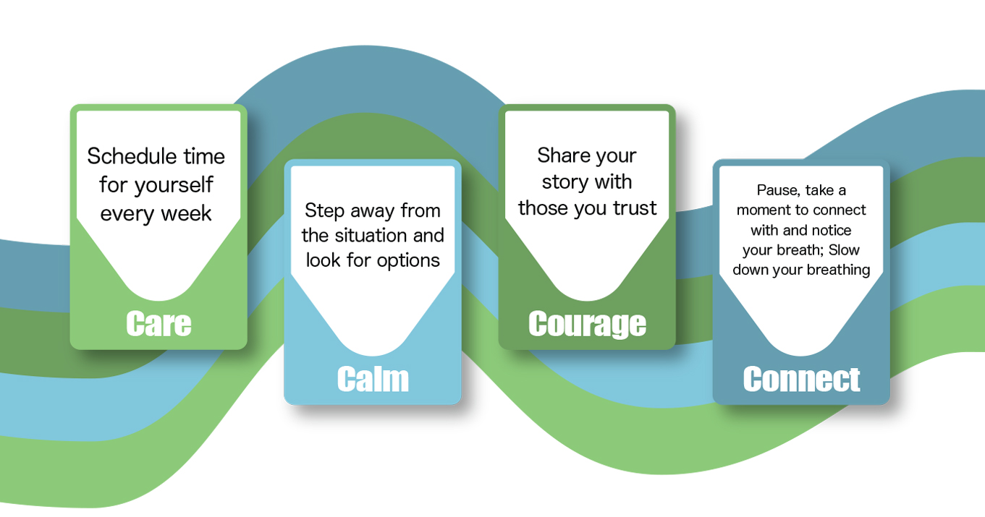
Using this Reflective Journal
Follow along in your Reflective Journal: pages 21 - 22 AND behind the Yellow Divider, pages 69 – 79

Slide 23
Building Reflective Capacity
Reflective Capacity – the ability to pause, step back, and think about the event, experience, or interaction.
Reflection provides the intentional pause that allows humans to learn, change, and grow.
The Remarkably Resilient Together Journal utilizes the evidence-based practice of journaling and self-reflection to help you strengthen your resilience by building your regulation skills and the practice of self-care.
Follow along in your Reflective Journal: pages 23 - 24

Slide 24
Remarkably Resilient Together (RRT) Call to Action
We need your help to bring the Remarkably Resilient Together resources to your community. Share with your clients, friends, family, and organization. To receive the RRT materials, please make a $50 tax-deductible donation to one of our non-profit partners that distributes the RRT materials.
https://teamtechinc.com/remarkably-resilient-together/

Slide 25
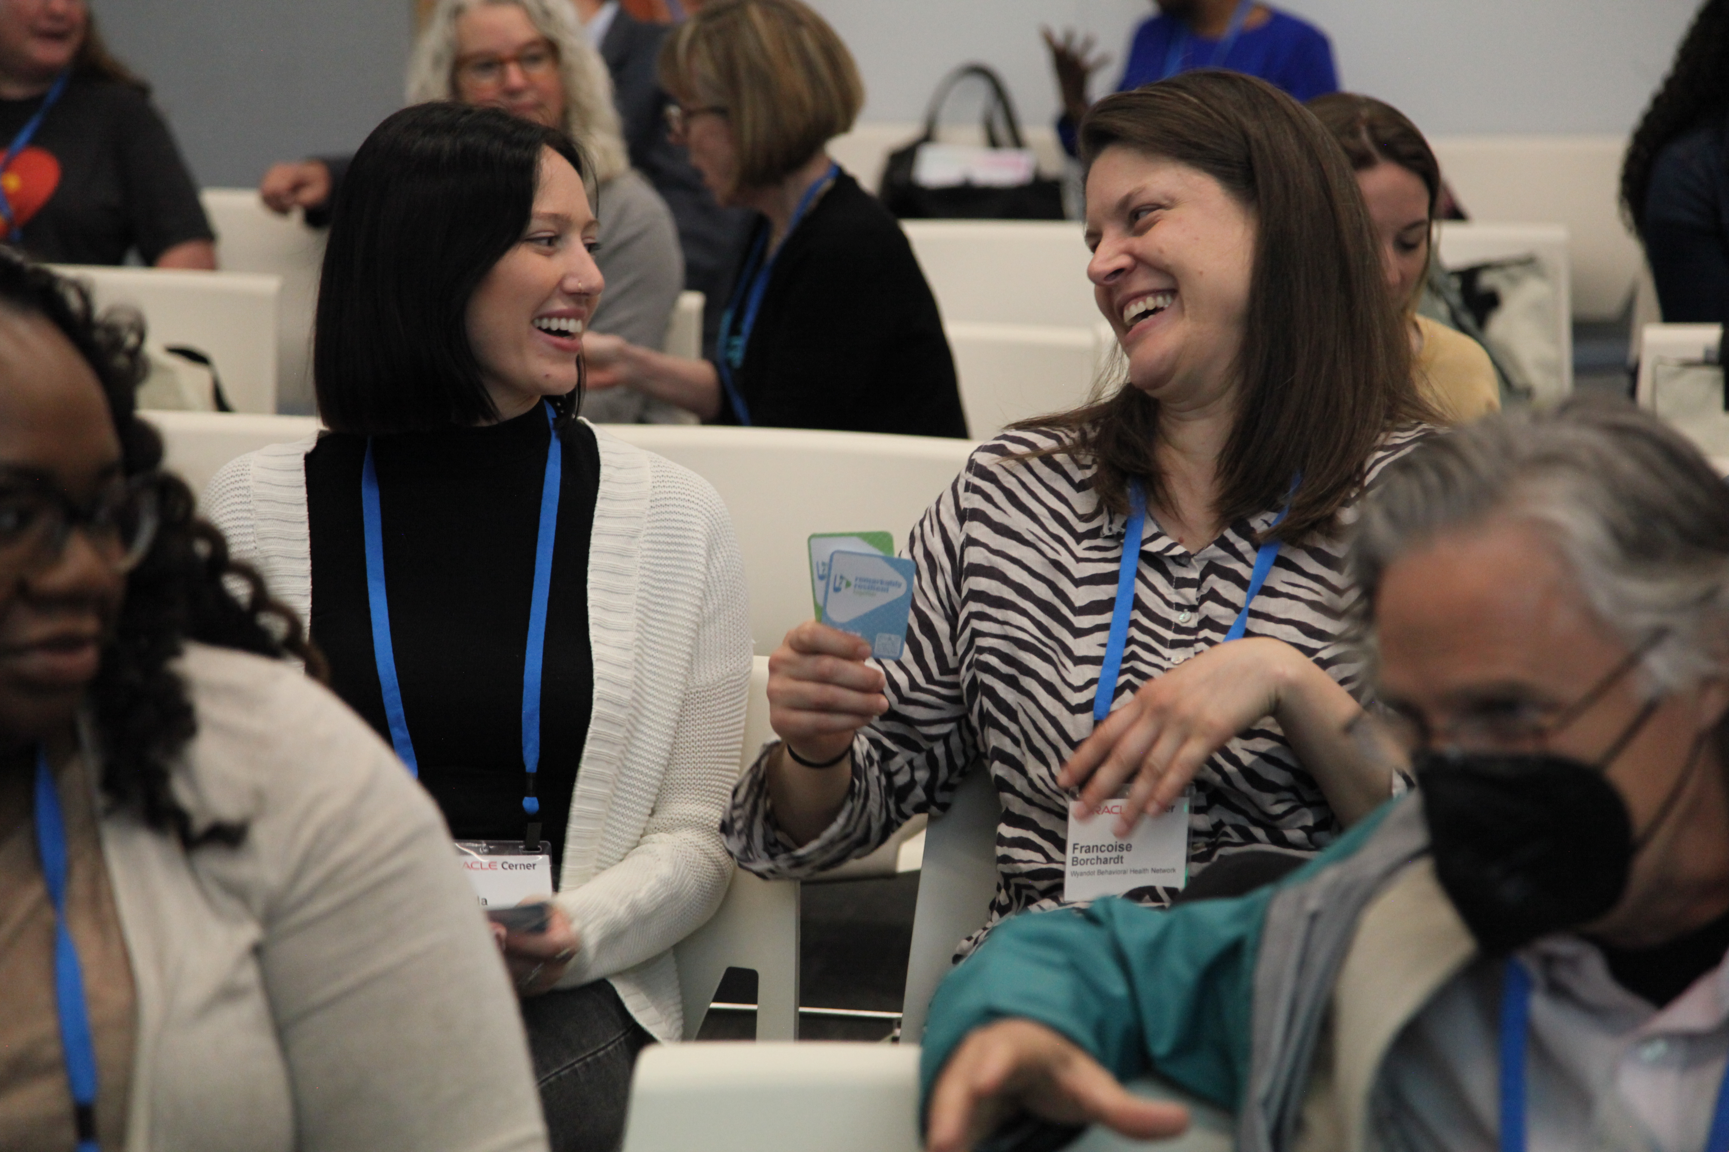
Remarkably Resilient Together
The Five R’s of Resilience which are part of the RRT Campaign:
Regulation (rolled out May 2023)
Relationships (coming Feb 2024)
Reflection (Late 2024)
Recovery (2025)
Response (2025)

Slide 26
Remarkably Resilient Together
For additional information about Remarkably Resilient Together, including co-branding opportunities, feel free to reach out to:
Kathleen Harnish McKune, TeamTech, creator of RRT, at Kathleen@teamtechinc.com
Visit www.remarkably-resilient.com
Thank you!!

